Slide 1
FileSync
A Distributed Peer-to-Peer File Synchronization System
Formal Proposal Presentation
Nisham Karki | Rabindra Neupane | Santosh Tripathee
Client / Domain Expert: Dr. Bei Xie
McNeese State University - CSCI 491

Slide 2

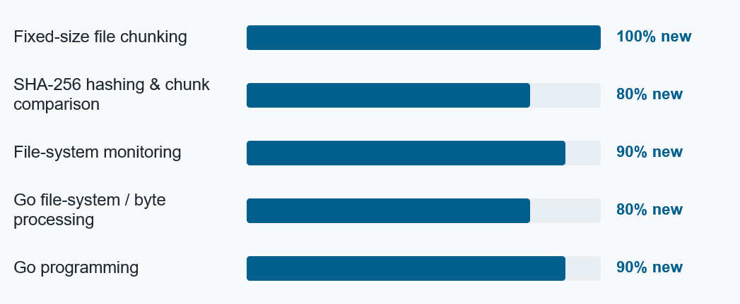
Nisham Karki
Sync Engine & Data Integrity Lead
Member 1 (Slide: 2,6,7,10,16)
Background
Technical base
BS Computer Science, McNeese State University (2022-present)
Developed a playable Tetris game
McNeese Bookstore web application
Task Manager application
Java, Python, PHP
HTML, CSS, AJAX/Fetch API
MySQL
Git / GitHub
NK
Sli

Slide 3

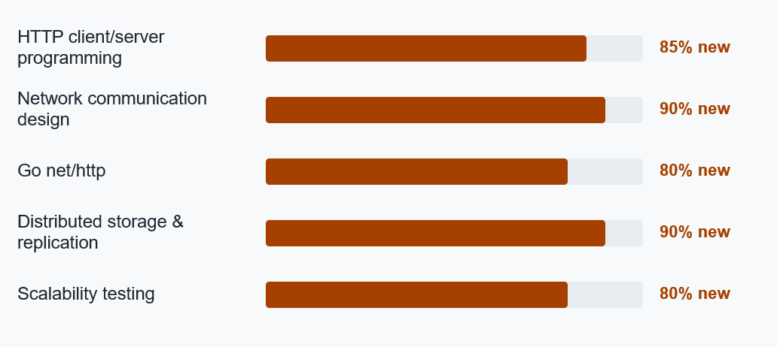
Rabindra Neupane
Networking & Distributed Storage Lead
Member 2: (Slide 3,8,11,13,14, 12, 17)
Background
Technical base
BS Computer Science, McNeese State University (2022-present)
McNeese BookStore Website
Stress Management Website
Tetris
Java, Python, HTML, CSS
MySQL, SQLite
Node.js, Express
Git / GitHub
RN

Slide 4

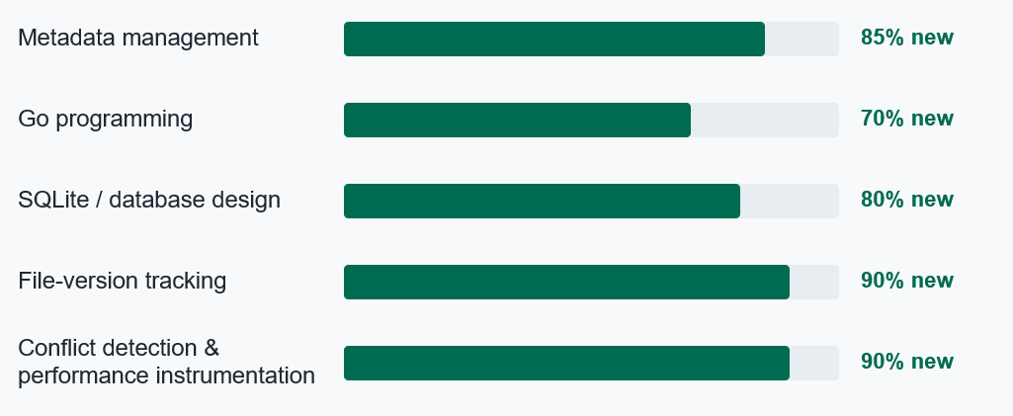
Santosh Tripathee
Version Management & Conflict Resolution Lead
Member 3: (Slide 1,4,5, 9,12,15)
Background
FileSync technical focus
BS Computer Science, McNeese State University (2023-present)
Served in the Nepal Police for almost six years before coming to the United States
Brings process discipline and reliability focus to the project
Go programming
SQLite / schema design
Version tracking and conflict detection
TypeScript / CSS for conflict UI
Performance instrumentation and data analysis
ST

Slide 5
Presentation roadmap
01
About FileSync
Overview and client expectation
02
Statement of need
Need this project fills
03
Goals Deep Dive
Goal-specific work, issues, and areas of learning
04
Technical Approach
Architecture, report deliverables, and timeline
05
Provisions & References
Special Provisions, assumptions, constraints and references

Slide 6
Project snapshot
Detect & divide
Synchronize & reconstruct
Verify & evaluate
Monitor synchronized files automatically
Split modified files into fixed-size chunks
Use SHA-256 hashes to identify changed chunks
Transfer only modified chunks
Operate across multiple FileSync clients
Reconstruct a complete usable file on the receiving device
Verify transferred data integrity
Track versions and preserve conflicts
Measure traffic, time, resource use, chunk size, and conflict latency

Slide 7
Statement of problem / need
Small edits to large files can be inefficient to synchronize
Whole file transfer waste network bandwidth
Independent edits create version conflict
Existing synchronization tools hide system process
FileSync lets us test synchronization process

Slide 8
System architecture
Go — Backend & sync engine
Wails — Desktop application framework
TypeScript + HTML/CSS — User interface
SQLite — Metadata & version storage
Go net/http — Client-to-client communication
SHA-256 — Chunk hashing & integrity verification
fsnotify — File-system change monitoring
Git/GitHub — Version control & collaboration
Application
Go | Wails | TypeScript | HTML/CSS
Data & Communication
SQLite | HTTP | JSON
Synchronization
fsnotify | SHA-256
Development
Git | GitHub | Node.js/npm

Slide 9
Client’s Project Goals
How much network traffic can block-level synchronization reduce compared with whole-file synchronization for different types of file modifications?
Bytes transmitted
Network savings
Sync time
Speed
CPU & disk
Resource cost
Chunks transferred
Transfer work
Conflict latency
Reliability
Chunk size
Design trade-off

Slide 10
Goals Deep Dive - Goal 1
Automatic file change detection and fixed-size chunking
1
2
3
4
5
Monitor
Chunk
Hash
Compare
Forward
Watch selected synchronized files for create, modify, delete, and rename events.
Divide modified files into fixed-size byte chunks.
Generate a SHA-256 hash for each chunk.
Compare new and previous hashes to identify changed chunks.
Pass identified modified chunks and metadata into synchronization.
Goal 1 - Potential issues
!
!
!
File watcher misses or repeatedly detects a file change.
Small edits may make multiple fixed-size chunks appear modified.
Chunking and hashing large files causes high CPU usage.
c

Slide 11
Goals Deep Dive - Goal 2
Synchronize only required chunks and reconstruct the newest file
1
2
3
4
5
Register
Request
Transfer
Store
Rebuild
Clients dynamically register instead of being hardcoded to three PCs.
Use metadata to determine which chunks are required.
Send only modified or missing chunks over the local network.
Track chunk locations and support basic replication across devices.
Combine existing and received chunks in the correct order.
Goal 2 - Potential issues
!
!
!
Network interruptions may cause incomplete or failed chunk transfers.
More clients increase communication and synchronization time.
A required chunk may be unavailable when a device storing it is offline.

Slide 12
Goals Deep Dive - Goal 3
Maintain reliability through integrity verification and conflict handling
1
2
3
4
5
Verify
Track
Detect
Preserve
Measure
Compare received chunk hashes with expected SHA-256 values.
Maintain file-version and base-version metadata.
Identify independent edits derived from the same prior version.
Keep both conflicting versions instead of overwriting one.
Record conflict-detection latency during evaluation.
Goal 3 - Potential issues
!
!
!
Transferred chunks may fail hash verification.
Incorrect metadata may cause missed or false conflict detection.
One conflicting version may accidentally overwrite another.

Slide 13
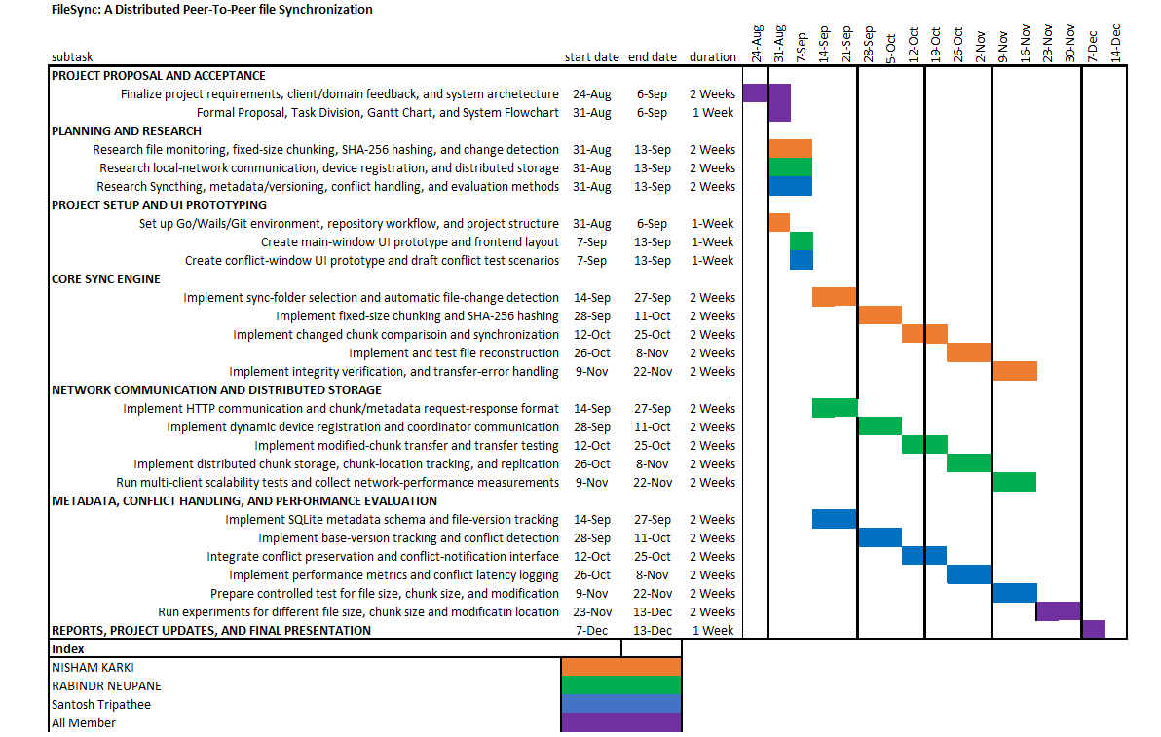
Gantt Chart

Slide 14
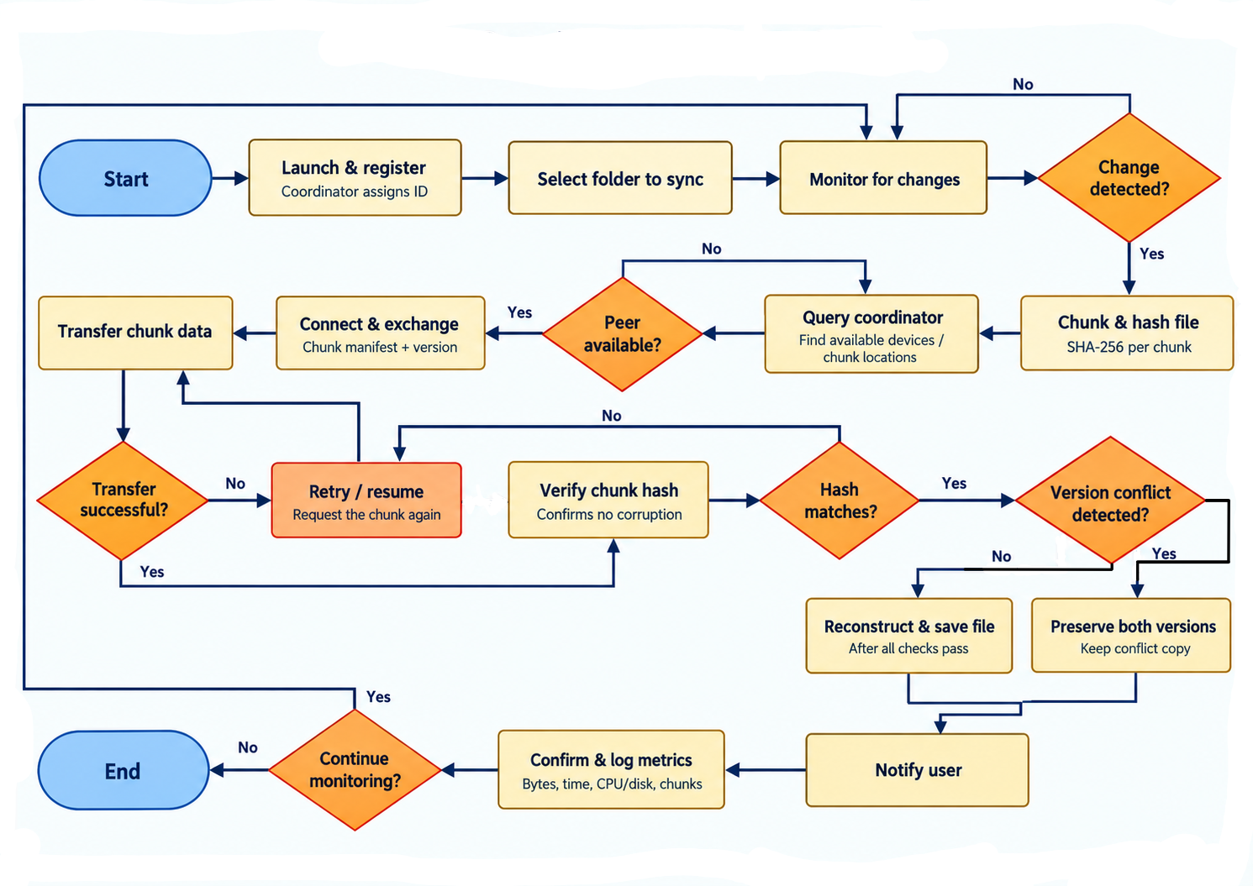
Software flowchart

Slide 15
Project provisions & constraints
Special provisions
Assumptions
Constraints
Use only team-owned or test data
Local-network educational prototype
Document third-party tools and licenses
No production-level security or backup guarantees
All members have capable development laptops
Shared local network is available for testing
At least two physical computers are available
Fixed-size chunking is used this semester
Fall 2026 semester timeline
Three-student team learning Go/Wails/distributed systems
Internet sync, advanced auto-merge, and production security are out of scope
Hardware/network variation may affect measurements

Slide 16
Thank You
FileSync - Distributed Peer-to-Peer File Synchronization
Nisham Karki • Rabindra Neupane • Santosh Tripathee
McNeese State University - CSCI 491

Slide 17
References
IEEE-style sources used in the proposal and Areas of Learning
[1] A. Tridgell and P. Mackerras, "The rsync algorithm," Technical Report TR-CS-96-05, Australian National University, Jun. 1996.
[2] A. Muthitacharoen, B. Chen, and D. Mazières, "A low-bandwidth network file system," Proc. SOSP, 2001, pp. 174-187.
[3] National Institute of Standards and Technology, "Secure Hash Standard (SHS)," FIPS 180-4, Aug. 2015.
[4] Syncthing Project, "Syncthing - Open Source Continuous File Synchronization," accessed Sep. 2026.
[5] The Go Authors, "The Go Programming Language Documentation," accessed Sep. 2026.
[6] SQLite, "SQLite Documentation," accessed Sep. 2026.
[7] D. S. Parker et al., "Detection of mutual inconsistency in distributed systems," IEEE Trans. Software Eng., vol. SE-9, no. 3, pp. 240-247, May 1983.

